Slide 1


SMART CAR PARKING
TEAM ID –SGH000288
TEAM LEADER– HAPPY PRAJATI
TEAM MEMBERS-
RAHUL SURANA
GUNJAN SHARMA
SHAH NEHAL
BHAUMIK NATHANI
RAVI PANCHAL

Slide 2
Abstract
Parking has become an major problem in metro cities like Chennai, Mumbai, and other big cities, especially for the parking spaces for hotels, restaurants, and movie theatres. So the aim of the project is to design an intelligent system that keeps a track of vacant parking spaces and shows the route to those specific parking space locations
The car will enter the parking entrance. Once car arrives, sensors will be activated to represent arrival of new vehicle. If there is no vacant parking space, then the gate doesn’t open and displays no vacant space message on the LCD SCREEN.
If parking space is available, then the system allots the parking space nearer to the exit. Once the parking space is allotted, led sign boards will show direction to the driver as of where to park. Once the car is parked, the system updates the number of vacant spaces as reduced by one.

Slide 3
features
Optimized parking
Reduced traffic
Enhanced User Experience
New Revenue Streams
Increased Safety
Decreased Management Costs
Real-Time Data and Trend Insight

Slide 4
FRAME WORKS AND ALGORITHM USED
CHERRYPY
MACHINE LEARNING
PYTHON
HTML AND JAVA SCRIPT
ARDUINO
MAT PLOT LIB
PY TESSARACT

Slide 5
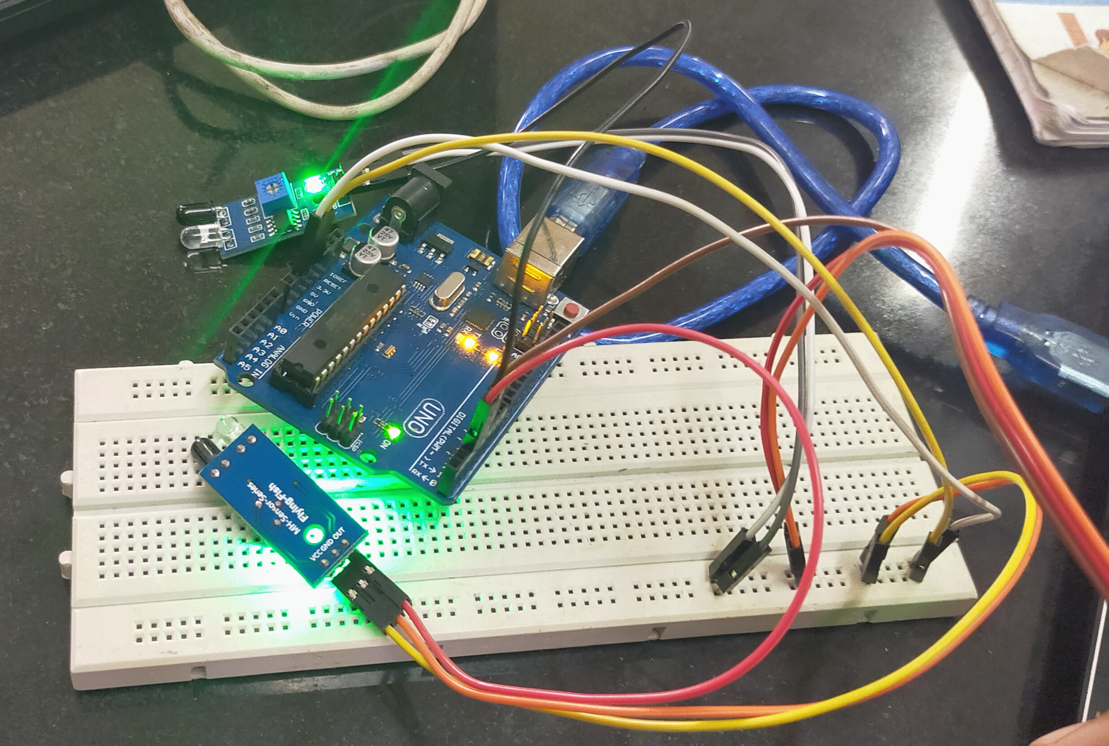
ARDUINO CIRCUIT:

Slide 6
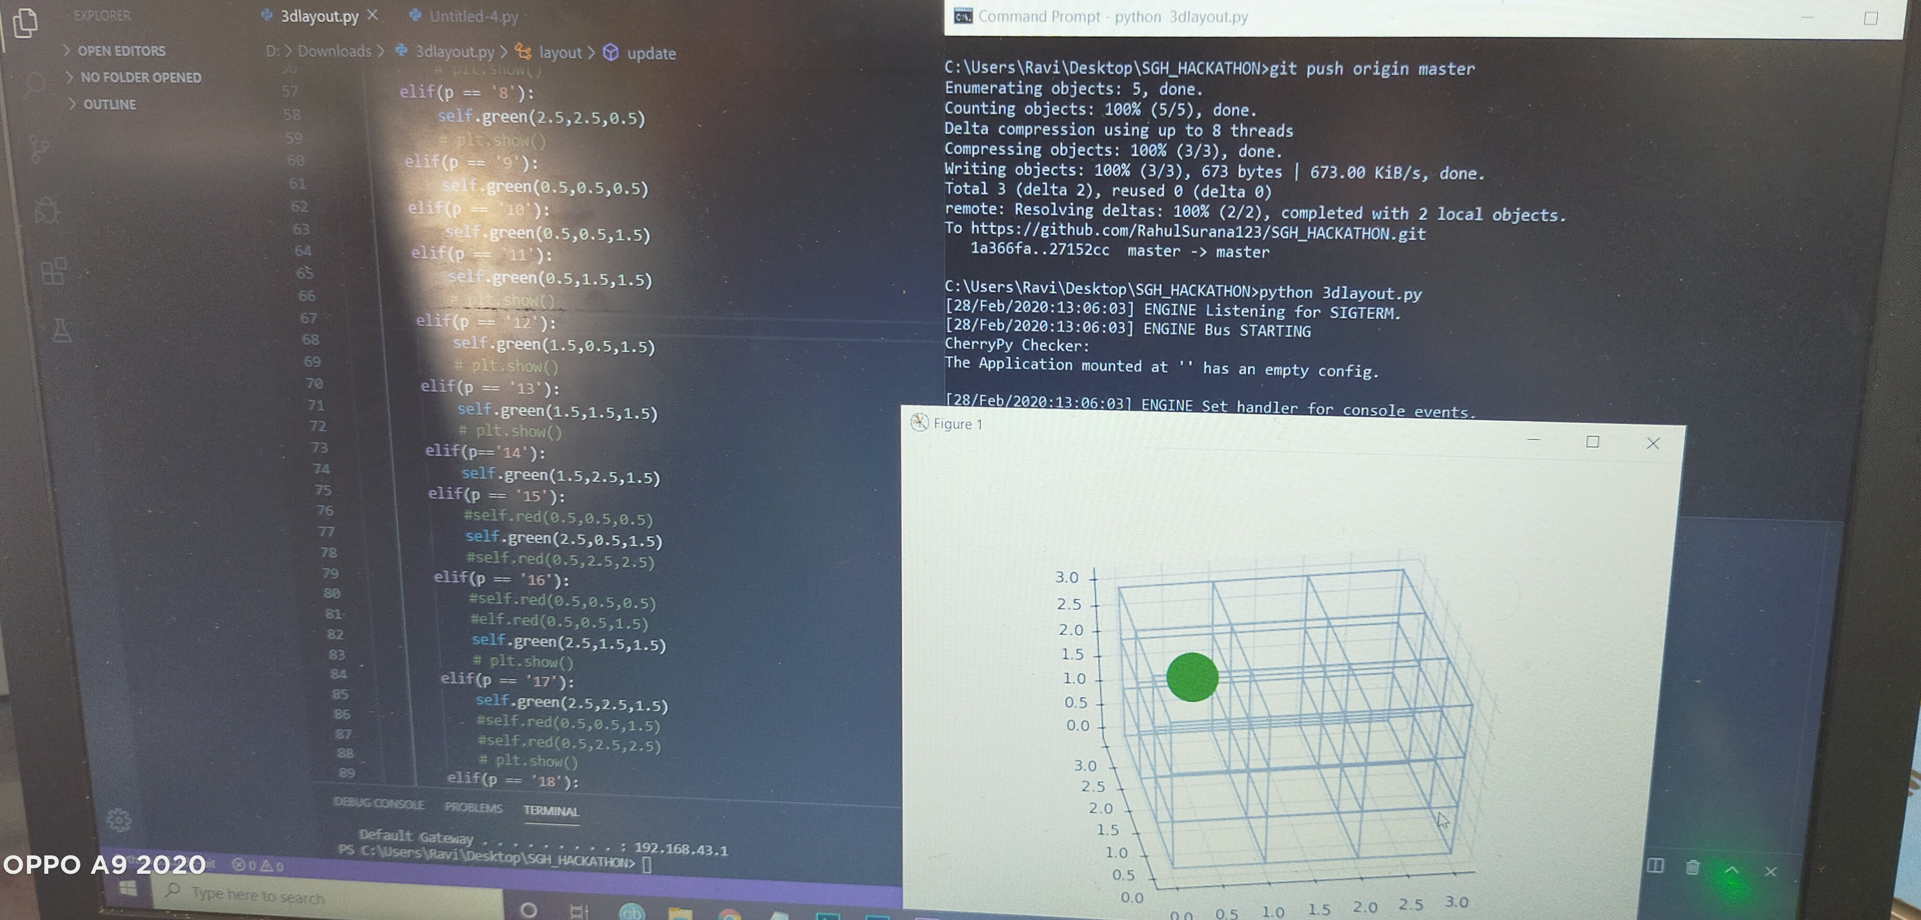
3D LAYOUT OF PARKING:

